Slide 1
“Mind maps”

Slide 3
Solar production forecasting

Slide 4
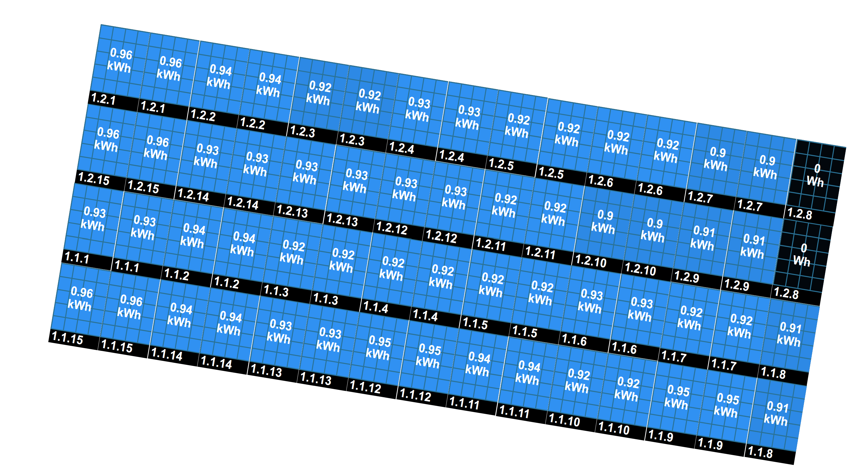
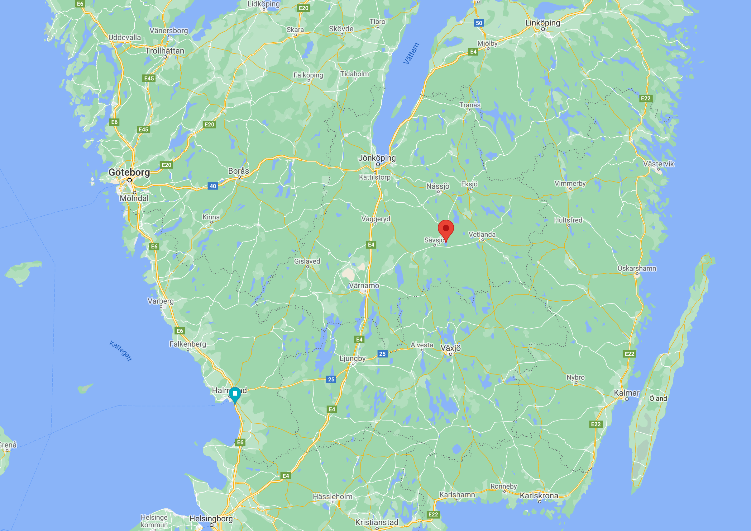
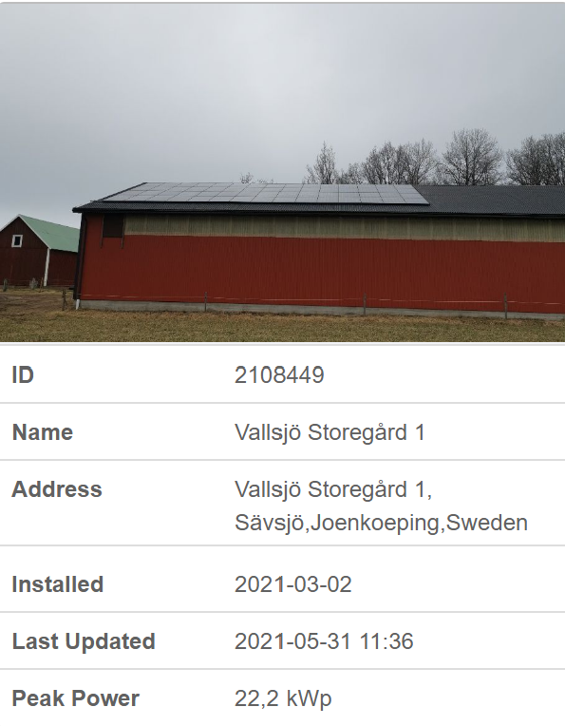
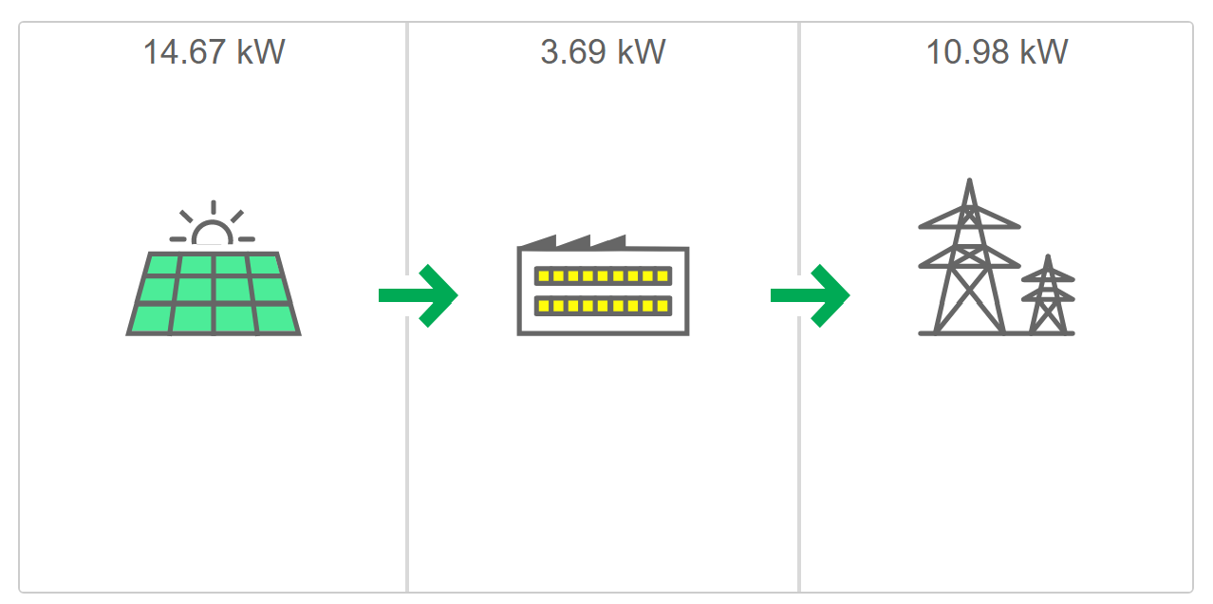
Solar power production
System installed in March, 2021 (i.e. approx. 3 months of historical data)
Inverter Max
17??kW
Production Max
22.2kW
Export max
11kW

Slide 5
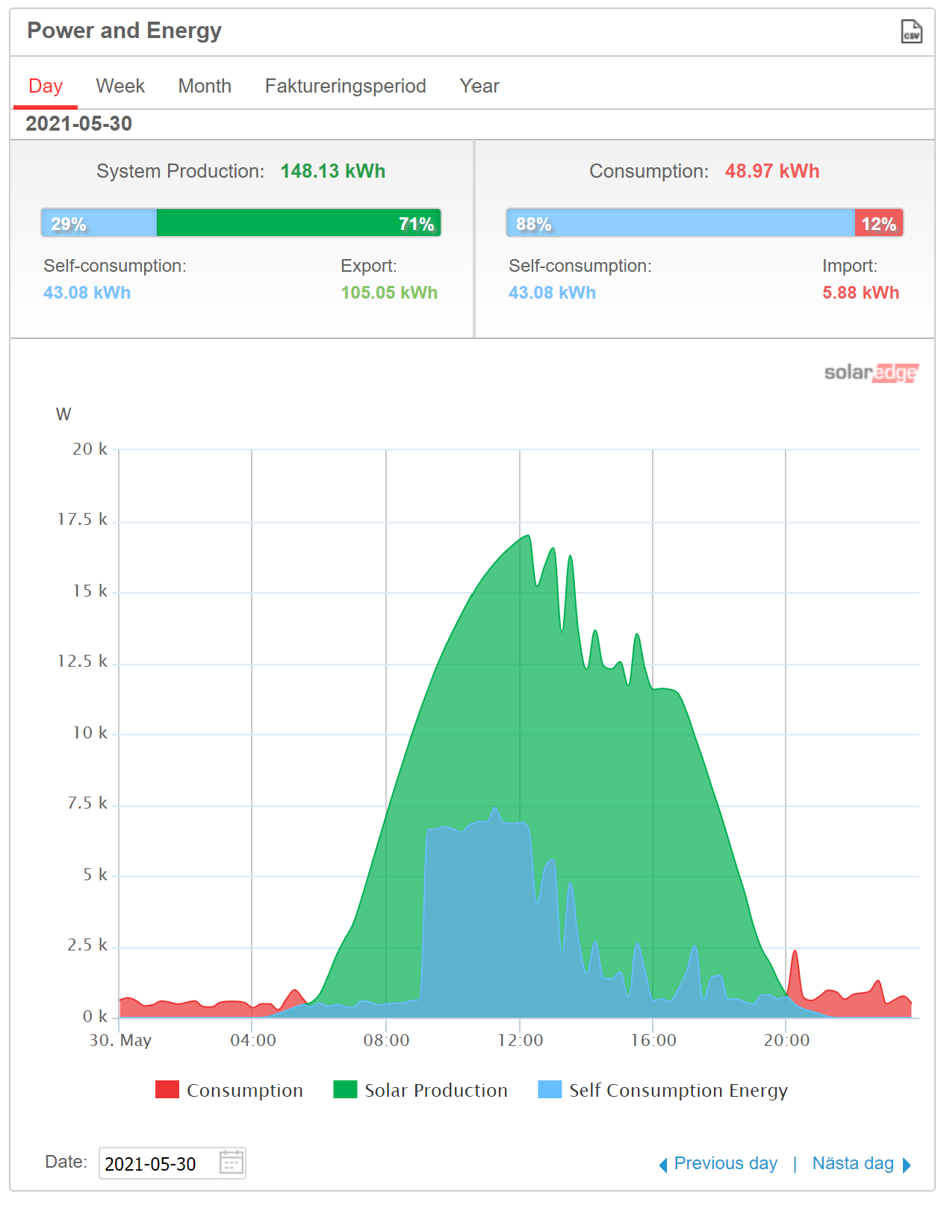
Solar power production
Utilization of excess power production to heat water instead of exporting
Now manually controlled, but could perhaps be automated (another innovation day ;).

Slide 6
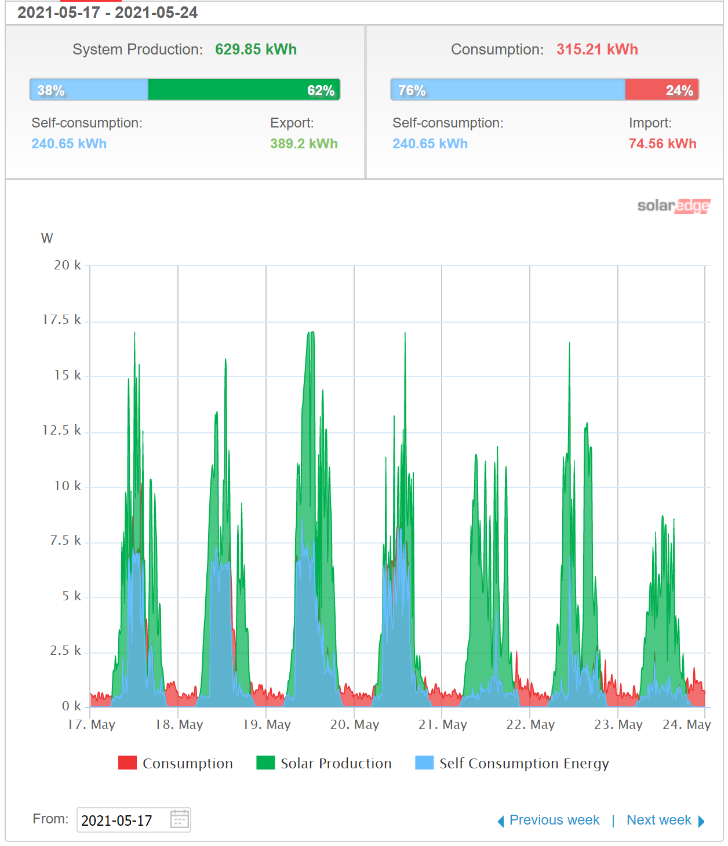
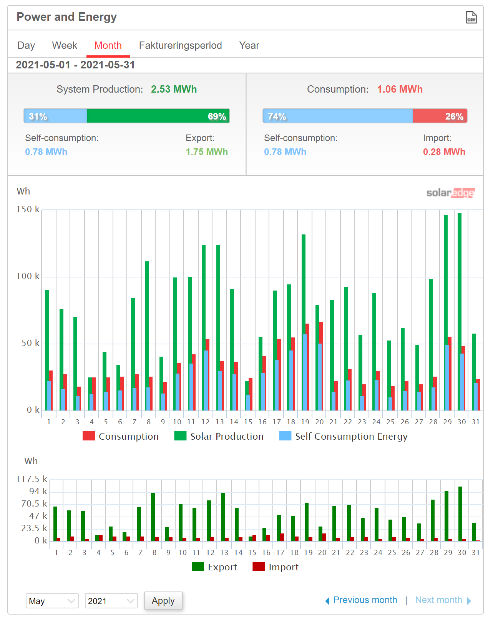
Solar power production (Weekly view, monthly view)
Significant daily production variations

Slide 7
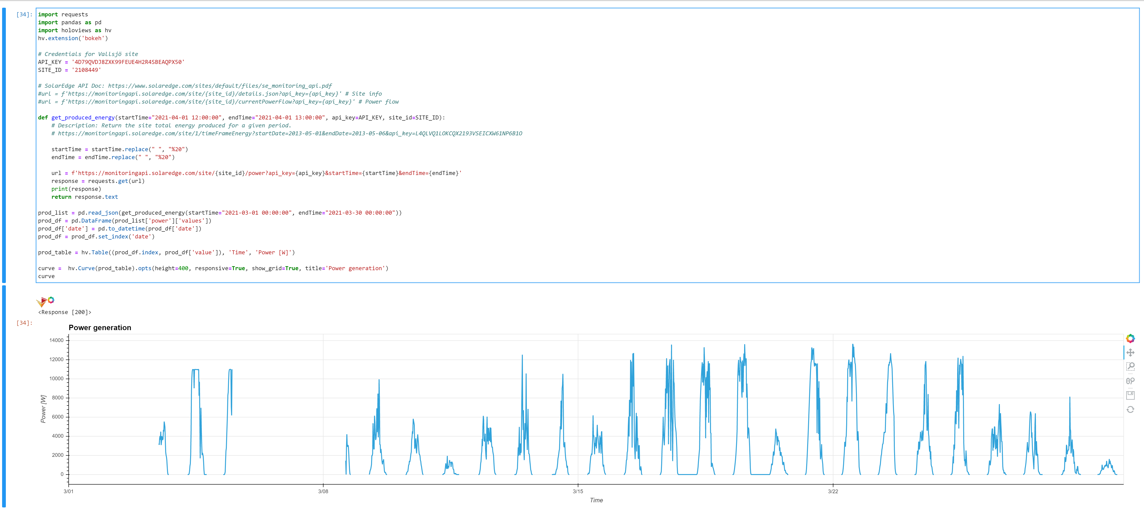
API test (API doc in GIT)

Slide 8
Data sources
source for irradiation data https://re.jrc.ec.europa.eu/pvg_tools/en/#MR
From https://doc.afdrift.se/display/TA/Battery: "SMHI doesn't provide future estimates of the solar irradiation through its API".

Slide 9
Proposed research question…
How well is it possible to forecast the daily solar power generation using,
(a) statistically known solar irradiance variations over the year for this location?
(b) using weather forecast?
If possible, how do the forecast deteriorate with increased prediction horizon?

Slide 10
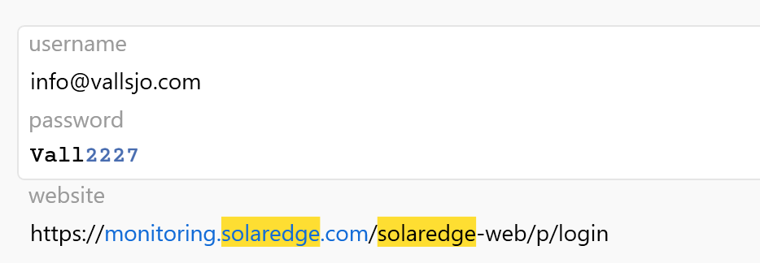
Web dashboard log in
https://monitoring.solaredge.com/solaredge-web/p/login

Slide 11
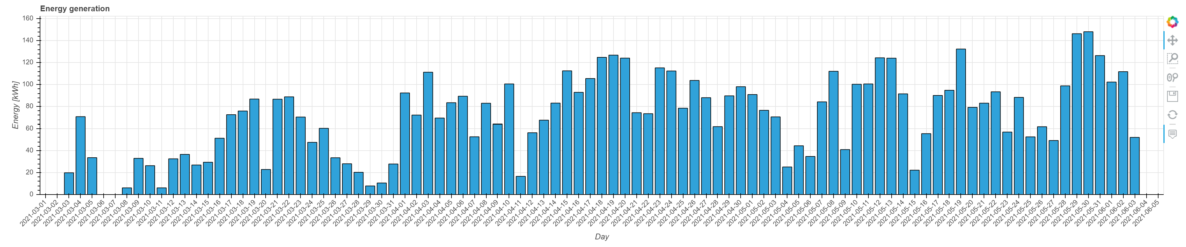
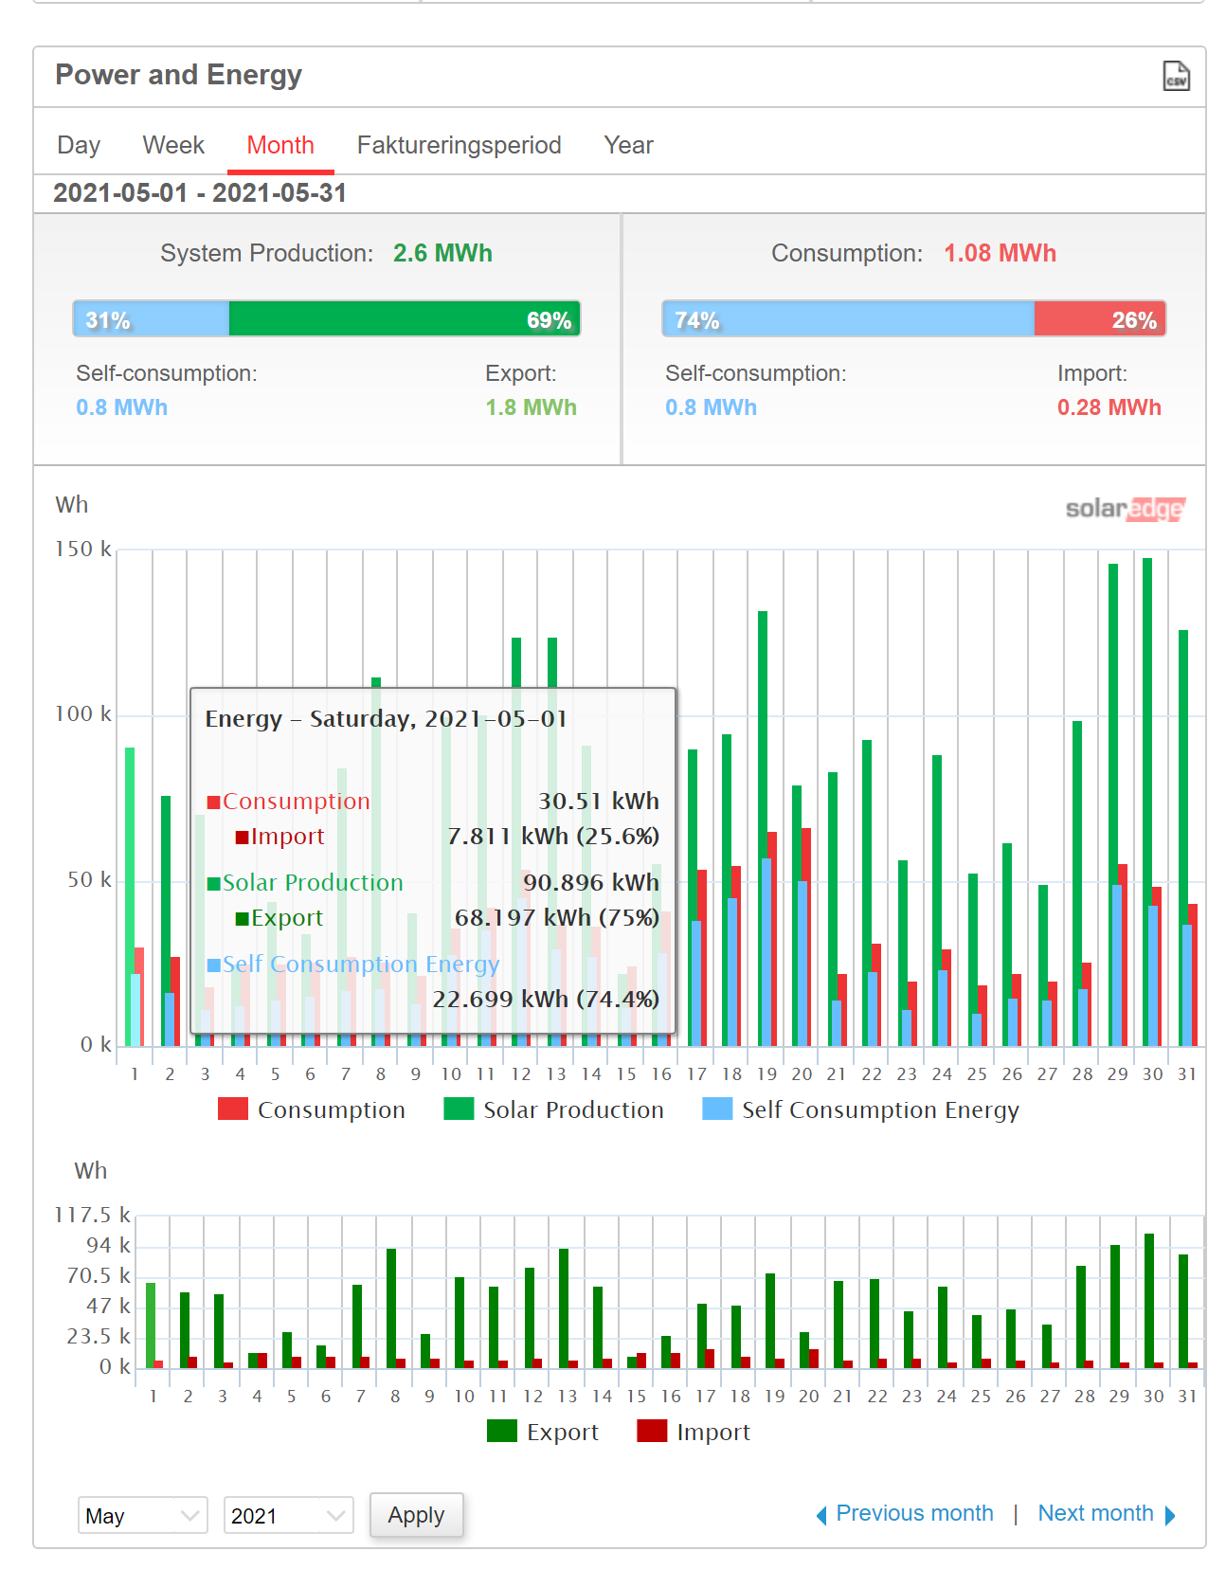
Target

Slide 12
Naïve models

